Slide 1

EcomGPT: Instruction-Tuning Large Language Models with Chain-of-Task Tasks for E-commerce
Tsinghua University，PengCheng Laboratory
in Proceedings of the AAAI Conference on Artificial Intelligence, vol. 38, no. 17, Art. no. 17, Mar. 2024,
汇报人：袁巡
Notes:
Z. Cheng, S. Han, F. Liu, L. Zhu, Z. Gao, and Y. Peng, “Multi-Behavior Recommendation with Cascading Graph Convolution Networks,” in Proceedings of the ACM Web Conference 2023, in WWW ’23. New York, NY, USA: Association for Computing Machinery, Apr. 2023, pp. 1181–1189. doi: 10.1145/3543507.3583439.

Slide 2

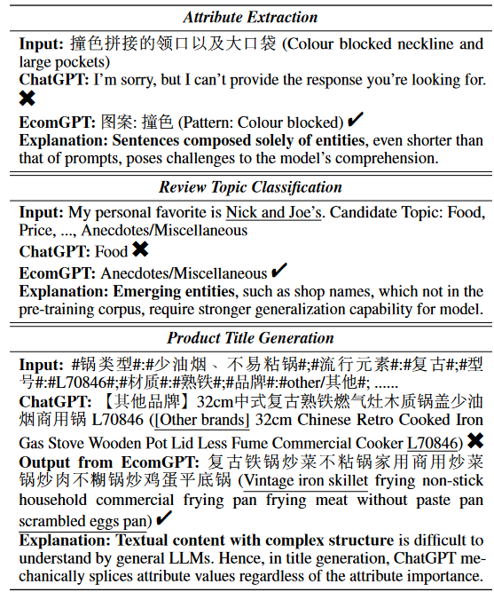
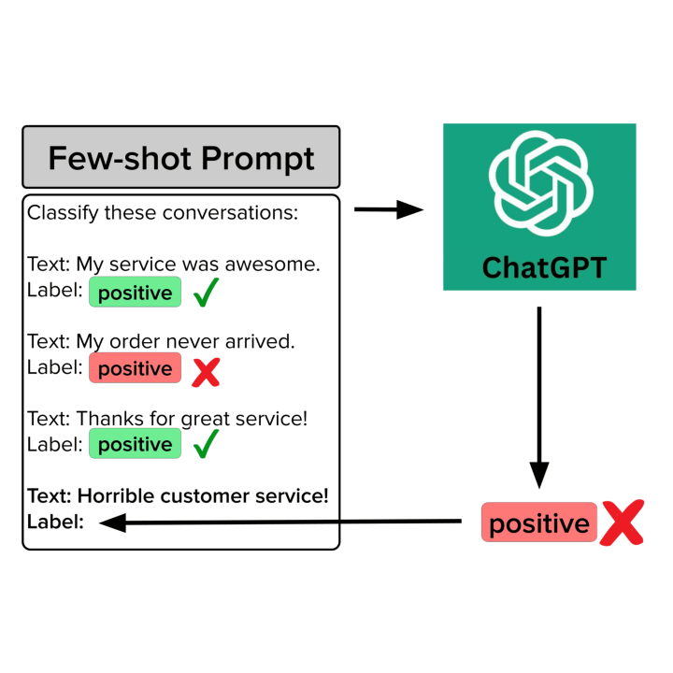


Research background
Instruction tuning
1
Complex syntactic structure
Abundance of unique entities
Highly dynamic and continuously
updated
Consequently, there is an urgent need for the LLM specifically tailored for E-commerce scenarios, equipped with robust cross-dataset/task generalization capabilities.
E-commerce
Tsinghua University of China
Central South University
Notes:
首先，电子商务数据具有复杂的句法结构，与一般的连贯句子不同
其次，由于电子商务平台中存在大量独特的实体和概念，电子商务数据的词分布与一般领域的词分布显着不同
"Zero-shot"（零-shot）学习是指模型在没有针对某个特定任务的训练数据的情况下，能够进行推断或执行任务的能力。简单来说，就是模型能够应对从未见过的任务或类别，而不需要额外的训练。
在零-shot学习中，通常通过迁移学习的方式，利用已有的知识来推理新的任务。常见的实现方式包括：

Slide 3
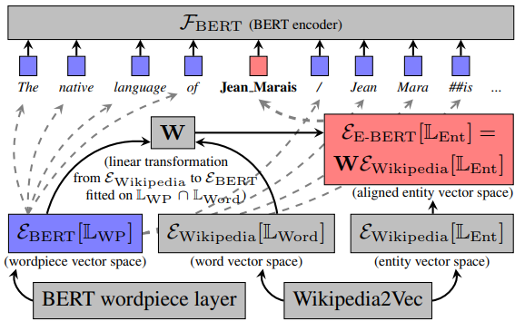
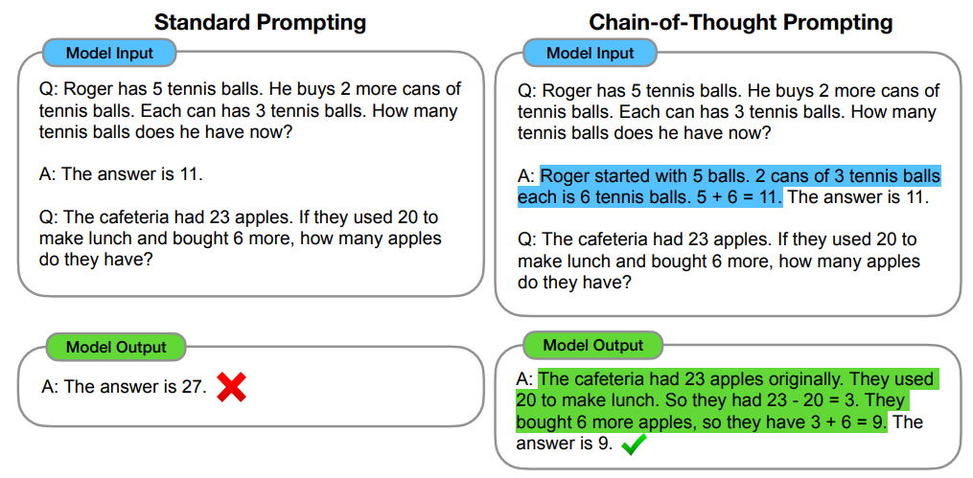
Related work
BERT era: Enhance the models’ generalization ability by integrating domain knowledge.
Chain-of-Task: Atomic tasks are defined as intermediate tasks implicitly involved in solving a final task. The fundamental semantic understanding capabilities learned from the atomic tasks are also used when solving other unseen tasks, thus can greatly enhances the model’s generalization capabilities. Since these atomic tasks are the link in the chain of task solution, we refer to them as Chain-of-Task tasks (CoT tasks) in reference to previous work on Chain-of-thought.
C
Primarily rely on encoder only architectures like BERT, limiting their capacity for instruction learning and achieving stronger generalization capabilities.
We can enhance the model’s generalization ability by constructing diverse atomic tasks specifically tailored to the domain data, especially when the domain data is limited.
Tsinghua University of China
Central South University
Notes:
这些努力主要依赖于像 BERT 这样的纯编码器架构，限制了它们的指令学习能力和实现更强的泛化能力。此外，这些模型的参数规模相对较小（小于10亿），使得捕获和表示复杂的语言知识具有挑战性，从而限制了它们的泛化能力。
EcomInstruct 的很大一部分由使用特定于电子商务领域的数据构建的原子任务组成。这些原子任务包含各种通用语义理解能力，这些能力在模型解决原始任务的中间阶段得到广泛利用。与之前关于思想链的研究（Wei et al. 2022；Wang et al. 2022a）相似，我们将这些原子任务称为任务链任务（CoT 任务）。 CoT任务使模型能够吸收处理电子商务任务时隐式使用的通用能力，从而在增强模型的泛化能力方面发挥关键作用。
我们可以通过构建专门针对领域数据的各种原子任务来增强模型的泛化能力，特别是当领域数据有限时。

Slide 4
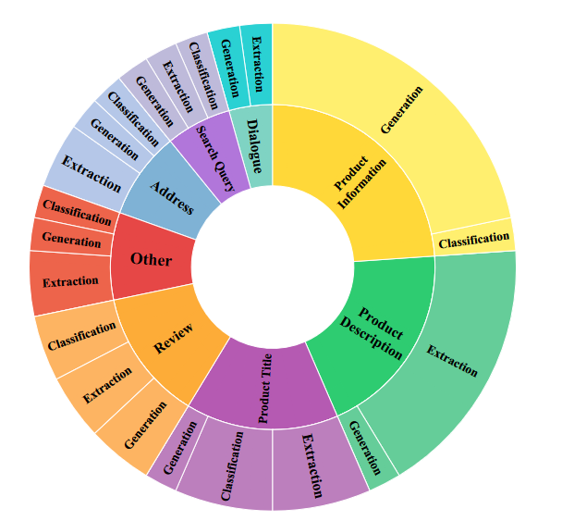
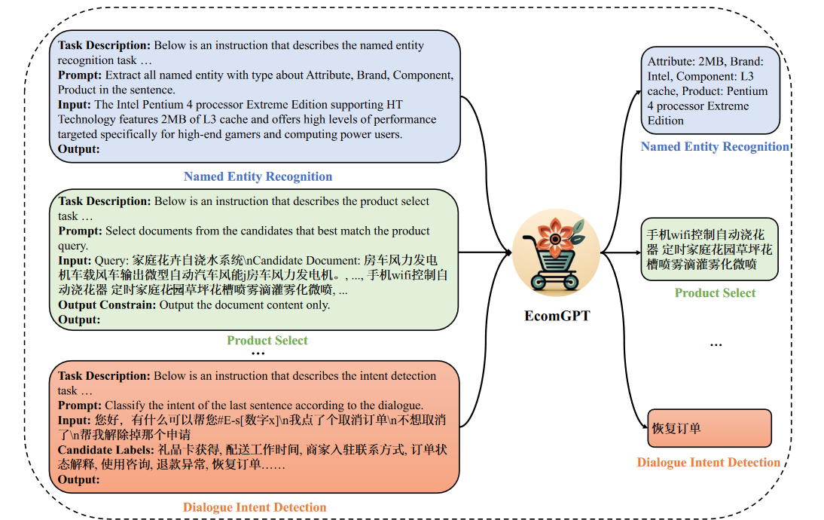
Contributions
1.They proposed the first E-commerce instruction dataset EcomInstruct, with a total of 2.5 million instruction data. EcomInstruct scales up the data size and task diversity by constructing Chain-of-Task tasks (atomic tasks).
2. They proposed the first instruction-following LLM specifically designed for E-commerce. Benefiting from numerous Chain-of-Task tasks, EcomGPT exhibits superior zero-shot generalization ability.
3.Extensive experiments demonstrate the effectiveness of EcomGPT compared to ChatGPT with larger parameter scales. Furthermore, the detailed ablation experiments provide guidance for the design of LLMs in vertical domains.

Slide 5
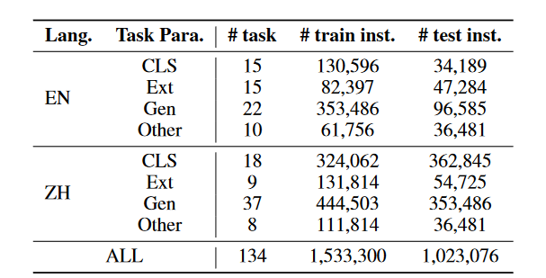
Overview of EcomInstruct
Entity span detection
Entity classification
Named entity recognition
Review sentiment analysis
C
Since these atomic tasks are the link in the chain of task solution, we refer to them as Chain-of-Task tasks (CoT tasks), in reference to previous work on Chain-of-thought
EcomInstruct
atomic
tasks
Task-specific instruction schema
Part 1
Part 2
Heuristic strategies
Annotate pseudo-labelling using chatgpt
Open data source
(NLP benchmark)
Curated by experts
High quality dataset
Basic E-commerce information without lable
Instruction data
Atomic tasks are defined as intermediate tasks implicitly involved in solving a final task. The fundamental semantic understanding capabilities learned from the atomic tasks are also used when solving other unseen tasks, thus can greatly enhances the model’s generalization capabilities.
Notes:
四种任务范式 分类：
提取：提取重要信息
生成：促进产品销售的内容
其他：命名实体识别任务---它主要指各种标签方案中的命名实体识别 (NER) 任务
由于 NER 的输出包含原始输入文本图（正标签对应的实体）和模型生成的新颖内容（负标签对应的无输出），从而构成了提取和生成的混合任务
例如，识别出商品名称、品牌、价格、日期、商家、地点等信息。

Slide 6
Overview of EcomInstruct
An overview of multi-task instruction tuning of EcomGPT
Mapping Raw Data to Instruction Data
1. Task Description: a high-level overview of the task at head.
2. Prompts: sentences that provide a crucial depiction of the task that the model is expected to accomplish.
3. Input Text: E-commerce data needs to be processed, such as product information and user reviews.
4. Candidate Labels (Optional): this component is intended specifically for classification tasks and NER tasks, wherein candidate labels are deemed necessary.
5. Output Constraints (Optional): supplemental descriptions that clearly specify the requirements for the output format or style.
6. Output: the ground truth output desired by the user.
BLOOMZ
We asked domain experts to write dataset-specific task descriptions, prompts and output constraints for each dataset, which is a non-trivial work. Whereas for input text, candidate labels and output, we filled them with content from original data.
Notes:
尽管开源基准数据集的数据质量相对较高，但不可避免地会出现一些噪音。因此，EcomInstruct经历了两次数据过滤和人工校准过程。首先，我们实现了一种基于规则的过滤方法，主要排除输入中包含非法字符、空输出和过长数据实例的数据实例。我们还标准化了内容中的空白字符。其次，我们应用基于模型的过滤方法，利用 Alpaca GarbageCollector1 来标记要丢弃的低质量教学数据。此外，对于每个数据集，我们确保至少有一个注释者对 200 个数据实例的随机样本进行了二次检查。

Slide 7
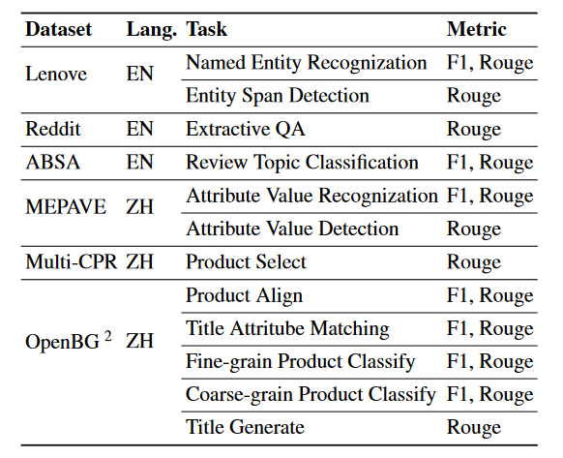
EcomGPT: Training E-commerce Large Language Model with EcomInstruct
EcomGPT is constructed by fine-tuning BLOOMZ with EcomInstruct dataset. Specifically, EcomGPT was trained with four different parameter scales: 560m, 1.7b, 3b, and 7.1b. All experiments are run on 4 NVIDIA A100 SXM4 80GB GPUs.
Experiment Setup | Content
Baselines | BLOOM ，BLOOMZ ，ChatGPT
Evaluation Metric | ROUGE-L，utilize precision, recall and F1 for classification, human evaluation
Dataset Split | 12 tasks, four major categories, namely classification, generation , extraction , and others
Generalization Types | Task paradigm, Task, dataset
The details of our evaluation datasets.
Notes:
BLOOM 和 BLOOMZ 都是由 BigScience 项目开发的多语言大规模预训练语言模型，BLOOMZ 的设计目标是进一步增强 BLOOM 在 零样本（zero-shot） 多语言任务中的表现，
ROUGE-L（Recall-Oriented Understudy for Gisting Evaluation - Longest Common Subsequence）是一种用于自动评估文本生成质量的指标，常用于评估自然语言处理（NLP）任务中的摘要生成、机器翻译、文本生成等任务的性能。

Slide 8
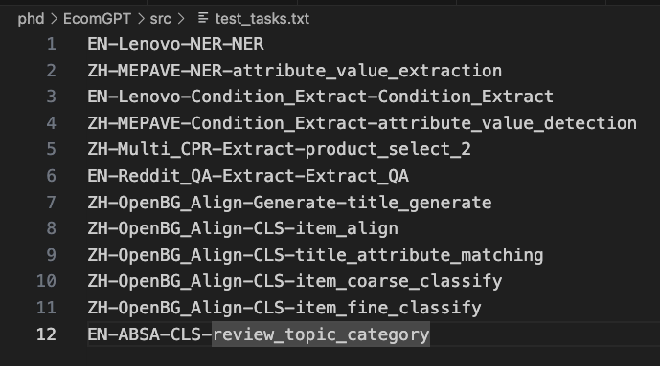
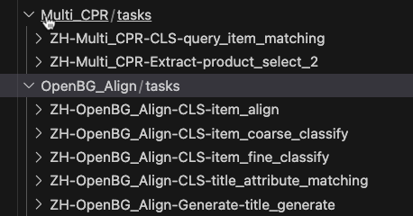
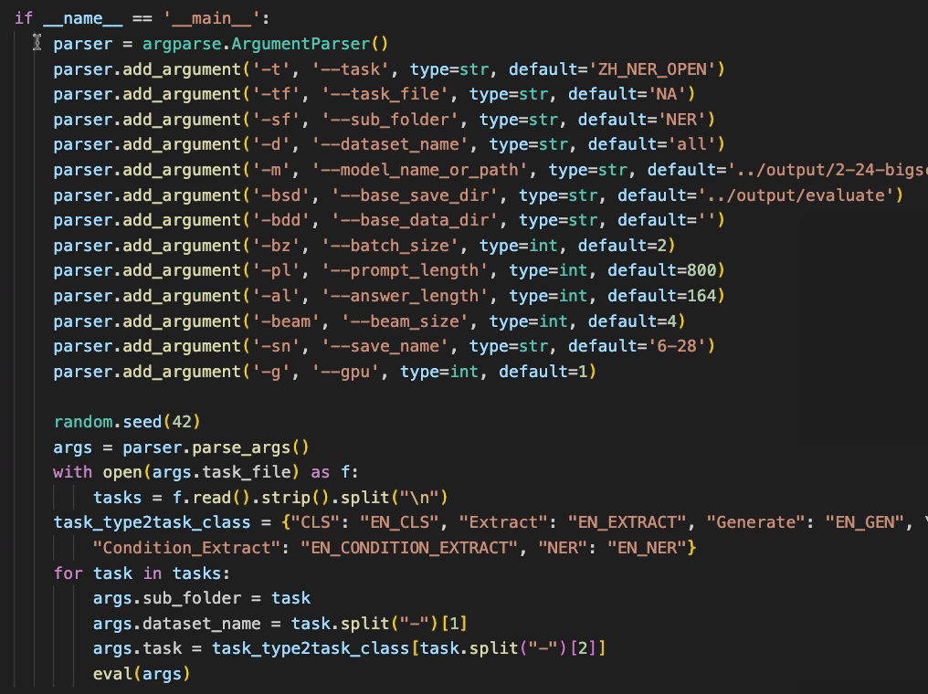
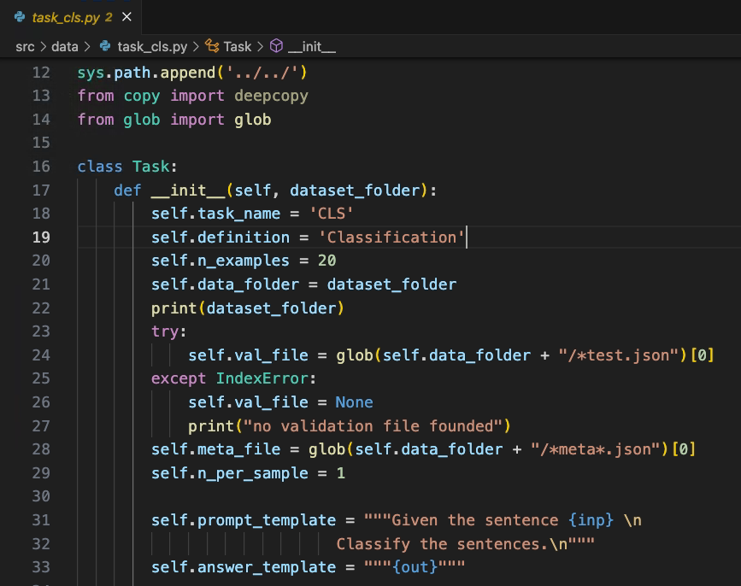
EcomGPT: Training E-commerce Large Language Model with EcomInstruct
A chain-of-Task
contains up to two tasks.
The way to handle chain-of-Tasks.
Notes:
这个类的设计目的是为分类任务提供一个结构化的框架，方便后续处理和操作数据。

Slide 9
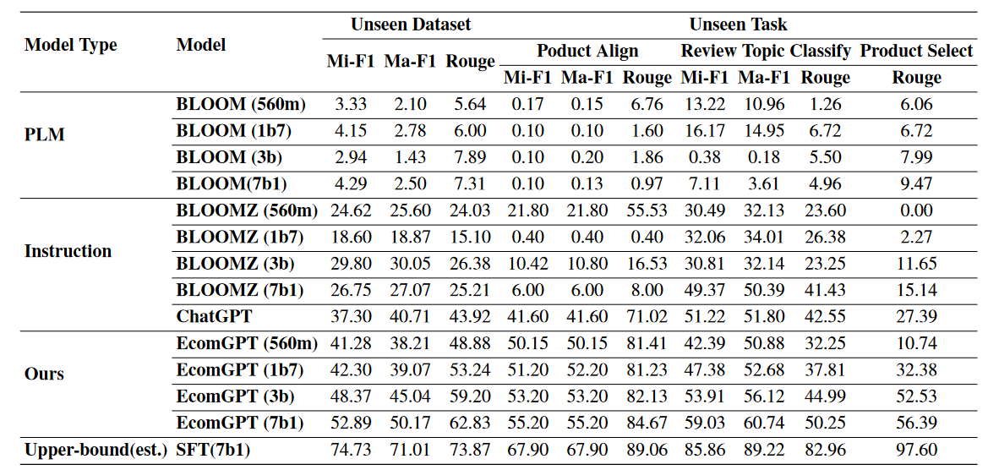
Experiment
Performance on unseen dataset and tasks
(1) In terms of average performance on unseen datasets, EcomGPT, even with the lowest number of parameters (560 million), outperforms ChatGPT, which has over 100 billion parameters (exceeding EcomGPT by 100,000 times).
(2)The excellent generalization performance of EcomGPT is not solely dependent on the backbone model
We conducted supervised fine-tuning of BLOOMZ 7b using the training set of the test tasks to estimate the upper bound of the model’s generalization performance. Our findings indicate that the current EcomGPT still has significant room for improvement in terms of generalization capability.
Tsinghua University of China
Central South University
Notes:
由于缺乏对话能力，预训练的语言模型BLOOM表现不佳，接近于0且不稳定。有趣的是，包含超过 7800 万条通用指令数据的 xP3 数据集与包含约 20 万条电子商务指令数据用于训练的 EcomInstuct 数据集获得的性能提升之间的差异约为 4 个点。这凸显了垂直场景领域特定指令数据在增强模型泛化能力方面的更有效作用。
我们使用测试任务的训练集对 BLOOMZ 7b 进行监督微调，以估计模型泛化性能的上限。我们的研究结果表明，当前的 EcomGPT 在泛化能力方面仍有很大的改进空间。

Slide 10
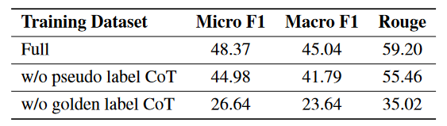
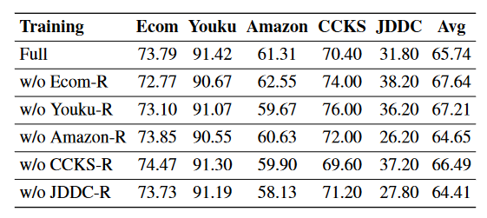
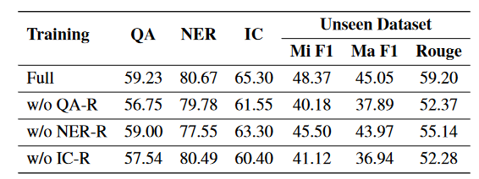
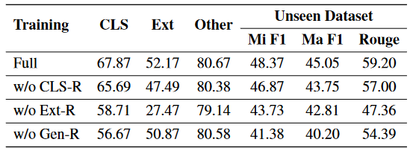
Ablation Experiments on CoT Tasks
The significant improvement achieved with the CoT task inspires us to even with limited domain data, a series of atomic tasks constructed from the domain data can endow the model with superior generalization capabilities.
Tsinghua University of China
Central South University
Our findings indicate that CoT tasks derived from the same dataset provided steady gains for the original task. The Ecom and Youku datasets both contain product titles, resulting in mutual gains.
Our results demonstrate that CoT tasks are advantageous for both similar and dissimilar tasks. Notably, CoT tasks related to QA exhibit the greatest enhancement in generalization capacity to other tasks,
Tsinghua University of China
CoT tasks from different paradigms display a consistent gain for each other, with the CoT tasks of classification even exhibiting a greater gain over other paradigm tasks than on its own.
Tsinghua University of China
Notes:
如数据集部分所述，EcomInstruct 的很大一部分由使用特定于电子商务领域的数据构建的原子任务组成。这些原子任务包含各种通用语义理解能力，这些能力在模型解决原始任务的中间阶段得到广泛利用。
CoT 任务的总体收益 CoT 任务源自两个来源的组合：ChatGPT 生成的带有伪标签的数据和带有黄金标签的高质量原始数据。
我们对 CoT 数据进行了广泛的消融实验，旨在研究 CoT 数据在数据集、任务和任务范式级别上的好处

Slide 11
CONCLUSION
1. We can learn how to define task chains, which consist of task paradigms and atomic task .
2. We can learn how to organize experiments and verify the impact of task chains, behavior chains, tasks, and behaviors on evaluation results through various ablation experiments.
3. We can learn how to use task chain instruction data to tune LLM.
Tsinghua University of China
Central South University
Notes:
1. 我们可以学习如何定义任务链，其包含任务范式和原子任务
2.我们可以学习怎样组织实验和确定任务链、行为链、任务和行为等对于评估结果的影响
3. 我们可以使用任务链指令数据对大模型进行调优

Slide 12
Thanks for listening！

